Slide 1
Challenges in Developing Real-World AI/ML Applications
Sujay Neupane and Pascal Kropf
(modified from Deirdre Mulligan, Nitin Kohli and Joshua A. Kroll, NIPS 2018)

Slide 2

Motivation
We want to build technology that people can trust and that support human values
A common wish list of requirements for “good AI/ML technology” usually includes things like:
Fairness
Accountability
Transparency
Interpretability
These are lofty goals, but what do we actually mean by them?
Notes:
These are all lofty goals, but what do we actually mean when we talk about these things.
We have seen this morning that when it comes to values, it isn’t that easy to come to a common understanding
We have a saying in Switzerland which goes something like: “Standing like a donkey in front of the mountain” which means standing in front of a big task and not really knowing where to start.
It seems that with regards to this wish list, this is a little bit where AI and ML stand now.

Slide 3

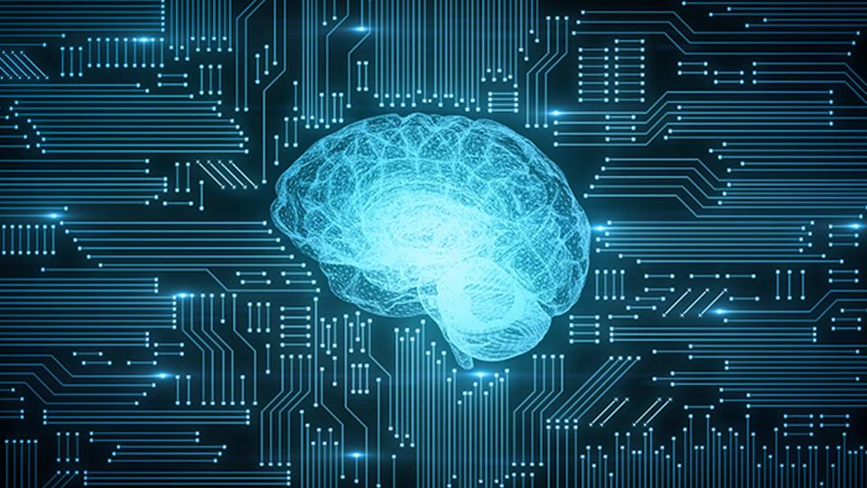
Curious Situation
As you can imagine, AI engineers and scientists are not the first ones to think about concept like these.
Many disciplines, mostly from social sciences and humanities, have been studying these in multiple ways.
But for some reason we have this curious situation:
Engineer + bridge ✅
Engineer + social scientist + AI ❌
Different language
= misunderstandings + useless arguments
Notes:
As you can imagine, AI engineers and scientists aren’t the first ones to think about these concepts. In fact, they have been studied in multiple ways by different disciplines, mainly in the social sciences.
But for a strange reason, it is completely natural for everyone to accept a sentence like “we need an engineer for building a bridge” but when it comes to social matters, engineers and scientists are perfectly at ease developing applications in their own corners and rarely even conceive of the idea of involving people from social sciences
A possible explanation for this dichotomy is that it is actually quite difficult to interact across disciplinary boundaries. Partly because words are sometimes used in very different ways which causes a lot of misunderstanding and unnecessary arguments.
So what lessons can we learn from other disciplines when it comes

Slide 4
Lessons from other fields
Why not ethics?
Instead
Ethics puts the focus on individuals
But many issues surrounding ML + AI applications don’t arise from people being unethical
Instead, they result from the short-sighted analysis of the problem at hand
Goal: In many social settings, we want the future to look different from the past
We don’t want to reproduce the current inequalities and biases
Hence, our analysis needs to incorporate the individual, social, political, and organizational dynamics and incentives
Notes:
So the obvious way to look at this would be to look towards ethics for a hint at these issues. But lessons from social sciences would suggest that this might not necessarily be the most productive

Slide 5
Operationalization
Problem
Justification
We want to make AI applications which are fair, accountable, transparent, and interpretable but we don’t know how to define these terms in usable (usually mathematical) form
Proposed solution: Let’s try to do it anyway
We should try to define them anyway for our application areas because:
It will help expose the limitations of our solutions
It will facilitate the communication of your goal
It will facilitate the evaluation of your solution
Notes:
We need to be able to operationalize these goals despite the fact that they aren’t definable in a very satisfactory way.
The reason we need this is because at the end of the day, we want to implement something.
But what would it mean for these mathematizations are correct.

Slide 6
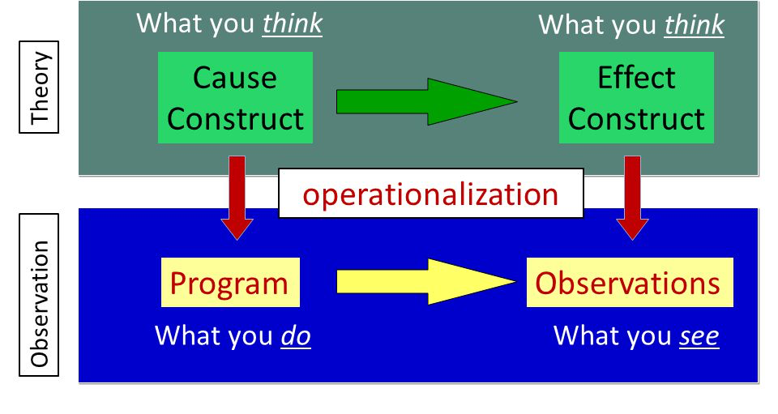
Operationalization
what goes on inside your mind, and your attempt to explain or articulate this to others. It contains the idea or construct of the outcomes or measures that you believe you are trying to affect
what you see happening in the world around you. This contains your actual program or treatment, and your actual measures or observational procedures.
From: socialresearchmethods.net

Slide 7
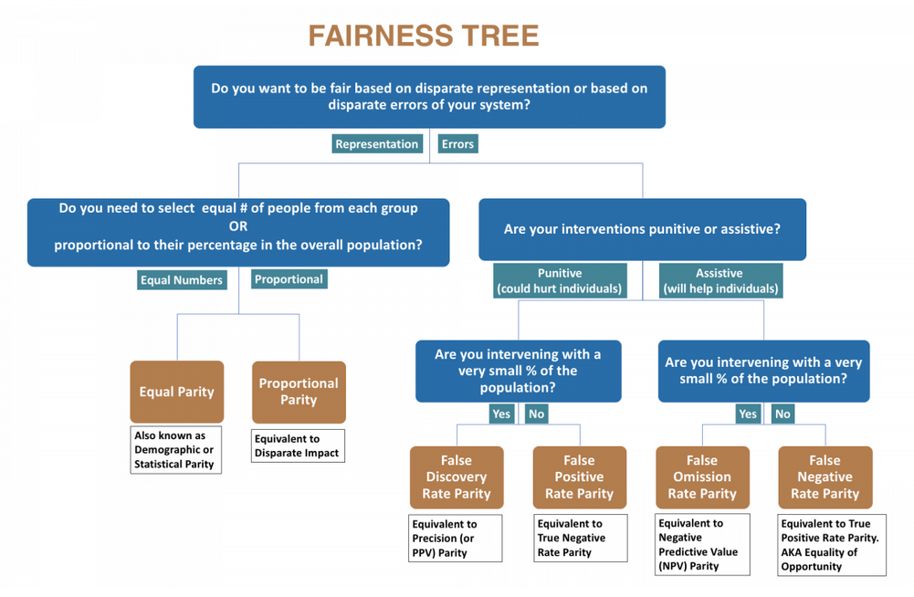
Common approaches: outcome based metrics
From: https://dsapp.uchicago.edu/projects/aequitas/
Notes:
Statistical parity: If you want each group represented equally among the selected set
Proportional parity: If you want each group represented proportional to their representation in the overall population

Slide 8
Challenges
Unfortunately, forced definition and operationalization will still not really solve our problem because:
Human values are complicated and multi-faceted => they resist definition
Contested concepts: We might agree on the notion that there is a concept out-there that we want to implement, but we don’t agree on how to instantiate it (e.g. the car example from session 1)
Even when we abstractly agree on what a concept should mean in a given context, it might not apply equally to all affected by it => famous example: recidivism risk rating of criminals
Notes:
A famous example is the recidivism rate of criminals: when someone gets arrested, we give them a score to try to assess the risk of them getting arrested again in a certain amount of time. If we calibrate that to the actual level of risk that people encounter, we find that we will give a higher risk to minorities because these people in fact have a higher risk of being arrested. By the way, this is true even absent a crime being committed.
But this offends our sense of fairness because it seems unfair that minorities get scores that are erroneously high more often than non-minorities
But if we try to correct for this, we end up in a situation where the score means something different for different people. And this also doesn’t seem like a fair situation

Slide 9
Case study: recidivism risk rating
Recidivism risk rating: After someone gets arrested, they are given a score reflecting the assumed risk that they will be arrested again within a certain timeframe in the future
Finding: If we calibrate the measure using the actual level of risk that people encounter, we find that minorities tend to receive a higher risk rating because they have a higher risk of being arrested in general (this holds true even absent of a crime being committed) => This seems unfair
But if we try to correct for it, we end up having a score which has a different meaning for different people => This also seems unfair
=> Perhaps mathematical correctness is not enough if we’re trying to capture human values => Maybe the problem is already included in the environment in which the model is built
Notes:
A famous example is the recidivism rate of criminals: when someone gets arrested, we give them a score to try to assess the risk of them getting arrested again in a certain amount of time. If we calibrate that to the actual level of risk that people encounter, we find that we will give a higher risk to minorities because these people in fact have a higher risk of being arrested. By the way, this is true even absent a crime being committed.
But this offends our sense of fairness because it seems unfair that minorities get scores that are erroneously high more often than non-minorities
But if we try to correct for this, we end up in a situation where the score means something different for different people. And this also doesn’t seem like a fair situation

Slide 10
Common ML thinking pathway
ML Researcher
None of my business?
Social issues
Problem solved
ML model
represents
Data
represents
World
This is incorrect because the problems that are being solved are not technical problems but socio-technical problems

Slide 11
A different view on fairness
From Law: fairness is not simply defined by the outcome but also by the process. Examples of fairness as process instead of rule
Due process
The ability to represent oneself
The ability to contest a judgment
Voting
The participation in the process is an important factor of fairness
GDPR: Individuals should be judged by individuals to protect against dignitary harms
Automated decision-making including profiling with legal ramifications is prohibited
Side-note: outcome-based measures are not able to capture process aspects of fairness
Notes:
If we look towards law, we can see that fairness is not just about rules but also about process (e.g. due process)
Important aspects are:
The ability to represent oneself
The ability to contest a judgement
Another example is voting: this is related to fairness because it allows me to participate in the process and

Slide 12
What has been said so far...
Outcome-based operationalizations are not sufficient to properly capture the intricacies contained in human values
Values can manifest themselves in both outcomes and processes
AI/ML researchers cannot evade the responsibility for the ramifications of their algorithms because algorithms only exist in a surrounding environment
So let’s have a closer look at this surrounding environment
Notes:
Can everyone follow up to here
How do you feel about this so far? Have you any comments or reservations with respect to this

Slide 13
ML/AI development pipeline
Model architecture
Data
Loss
Validation
We generally tend to think of the loss function and the architecture as being the places to enforce desired behavior because it allows us to restrict the class of admissible models
But we often forget a crucial fact about the nature of data in this process.
Data is not truth ⇔ Data is abstraction
Moreover: Model is an abstraction of Data
Notes:
If we look at the ML/AI training pipeline, it usually goes something like Data -> Model Architecture -> Loss -> Validation

Slide 14
Abstracting the world
Abstracting the world into data and models is a really hard problem!
This is partly due to the fact that all empirical data depends on measurement
An interesting anecdote about measurement: how long is the border between Spain and Portugal?
But measurement ≠ objective clearcut mechanism (all data is theory-laden)
But if something like length can be hard to measure, how about non-observable constructs such as risk?
Notes:
We tend to think of measurement as some objective clearcut mechanism. But this is definitely not the case because it is a well-known finding from the philosophy of science that all data is theory-laden
An interesting story about data: Does the length of the border between countries influence the likelihood of them going to war with each other
A lot of concepts that we want to capture with ML are non-observable => they are purely theoretical and don’t exist outside of our models
Again this is not something special about ML, this is very well known for example to people who want to develop tests or assessments
An approach to reasoning about this problem is called construct validity.

Slide 15
Central difficulty
A lot of concepts (i.e. constructs) that we want to capture with ML/AI are non-observable => they are a purely theoretical construction
Knowing this, how can we assess whether:
Our operationalizations are accurate translations of the construct?
Our program/intervention accurately produce what we intend?
Again this is nothing special about ML/AI. This is very well known by people who want to develop tests for example
Social sciences have developed an approach to reasoning about this problem which they call construct validity
Notes:
A lot of concepts that we want to capture with ML are non-observable => they are purely theoretical and don’t exist outside of our models
Again this is not something special about ML, this is very well known for example to people who want to develop tests or assessments
An approach to reasoning about this problem is called construct validity.
There are a few different ways in which construct validity is defined in literature but it generally goes somewhat like the following
Common threats to construct validity: (1) poorly defined constructs (2) confounding constructs (3) influence of different testing or intervention (4) unknown social factors (5) other effects, such as time, scale, bias, experimenter effects,

Slide 16
Construct Validity
Construct validity is basically assessing how accurately your ideas and/or theories have been translated into actual procedures or measures. (are we measuring what want to measure? Is our data representing what we think it represents?)
To establish construct validity, you have to:
set the construct you want to operationalize (e.g., self esteem) within a semantic net (or "net of meaning"). This means that you have to tell us what your construct is more or less similar to in meaning
provide direct evidence that you control the operationalization of the construct -- that your operationalizations look like what they should theoretically look like
provide evidence that your data support your theoretical view of the relations among constructs
Notes:
In order to argue that your measures had construct validity under the MTMM approach, you had to demonstrate that there was both convergent and discriminant validity in your measures. You demonstrated convergent validity when you showed that measures that are theoretically supposed to be highly interrelated are, in practice, highly interrelated. And, you showed discriminant validity when you demonstrated that measures that shouldn't be related to each other in fact were not.
Common threats to construct validity: (1) poorly defined constructs (2) confounding constructs (3) influence of different testing or intervention (4) unknown social factors (5) other effects, such as time, scale, bias, experimenter effects,

Slide 17
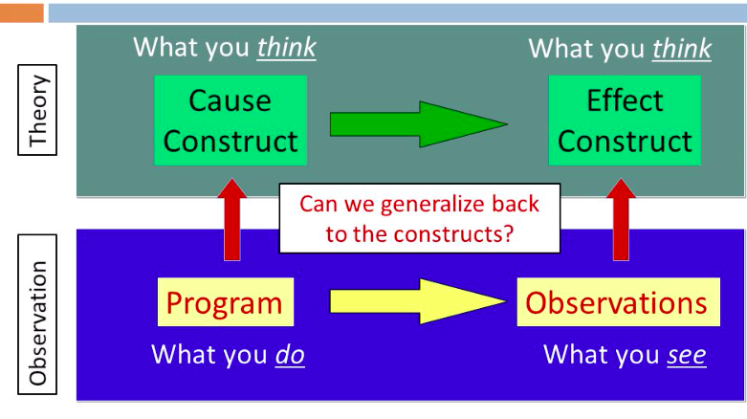
Instead of hoping that data magically replace thinking, we should worry about having a good construct validity
Notes:
Talk about Brain Reach here

Slide 18
Key take-home messages
There is no substitute for thinking
Both data and models are abstraction and not truth
When building models or agents, you carry part of the responsibility of how they interact with the world
Building “good” AI/ML applications is a socio-technical problem. It requires input from multiple fields of study

Slide 19
Further readings
On ethics and responsibility in ML/AI:
The Montreal Declaration: https://www.montrealdeclaration-responsibleai.com/the-declaration
The Moral Character of Cryptographic Work, paper by Phillip Rogaway
Social Science Research Methods: https://socialresearchmethods.net/
On measurement and biases:
Thinking fast and slow, book by Daniel Kahneman
Predictably irrational, book by Dan Ariely
What Is This Thing Called Science?, book by Alan Chalmers
Aequitas, online audit resource https://dsapp.uchicago.edu/projects/aequitas/
Notes:
Before going back to start the lab session, I would like everyone to have a look at the first link in there

Slide 20
Feedback
Again please fill out the google feedback form

